Slide 1

AIC
Kenichiro McAlinn

Slide 2
Model Selection
Model A
?
Model B
Compare using…
Total error
R squared
Adjusted R squared
AIC
BIC
DIC …

Slide 3
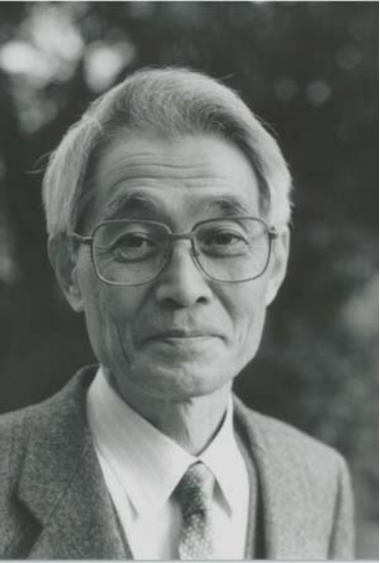



AIC
AIC
Akaike Information Criterion
Models should be measured by
balancing it’s fit and complexity
Hirotsugu Akaike (1927-2009)

Slide 4
Model Fit
True distribution: Q
Model distributions: P_{A} P_{B}
Measure the distance: d(Q, P)
Measure the distance: d(D, P)
Likelihood:

Slide 5

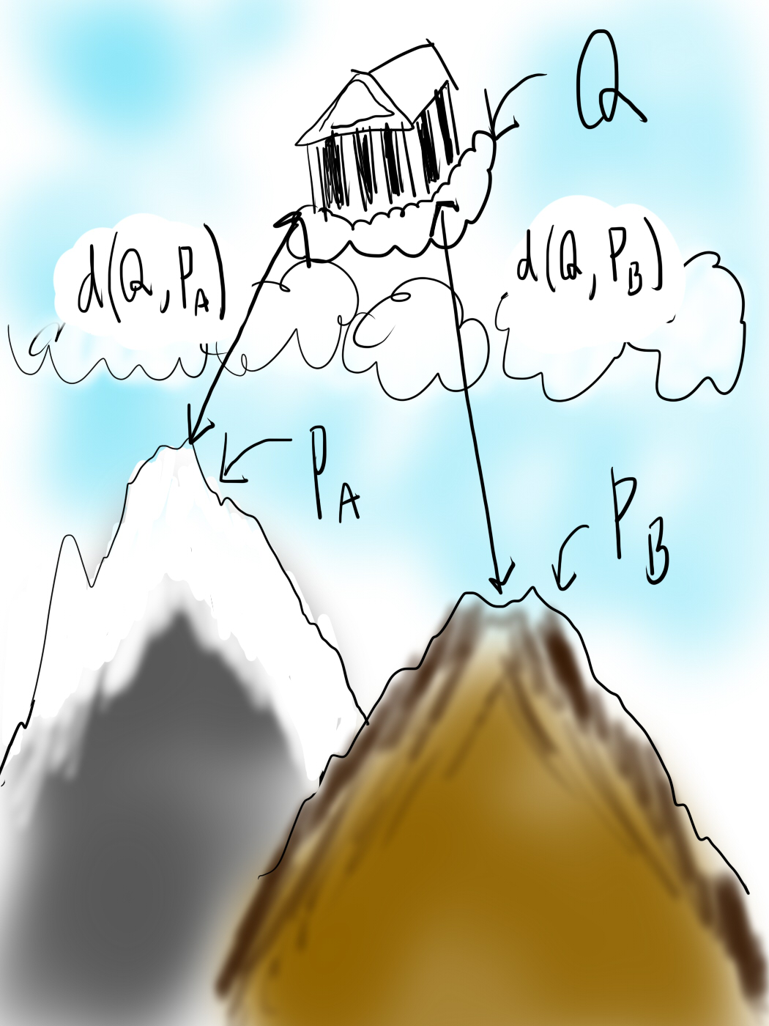
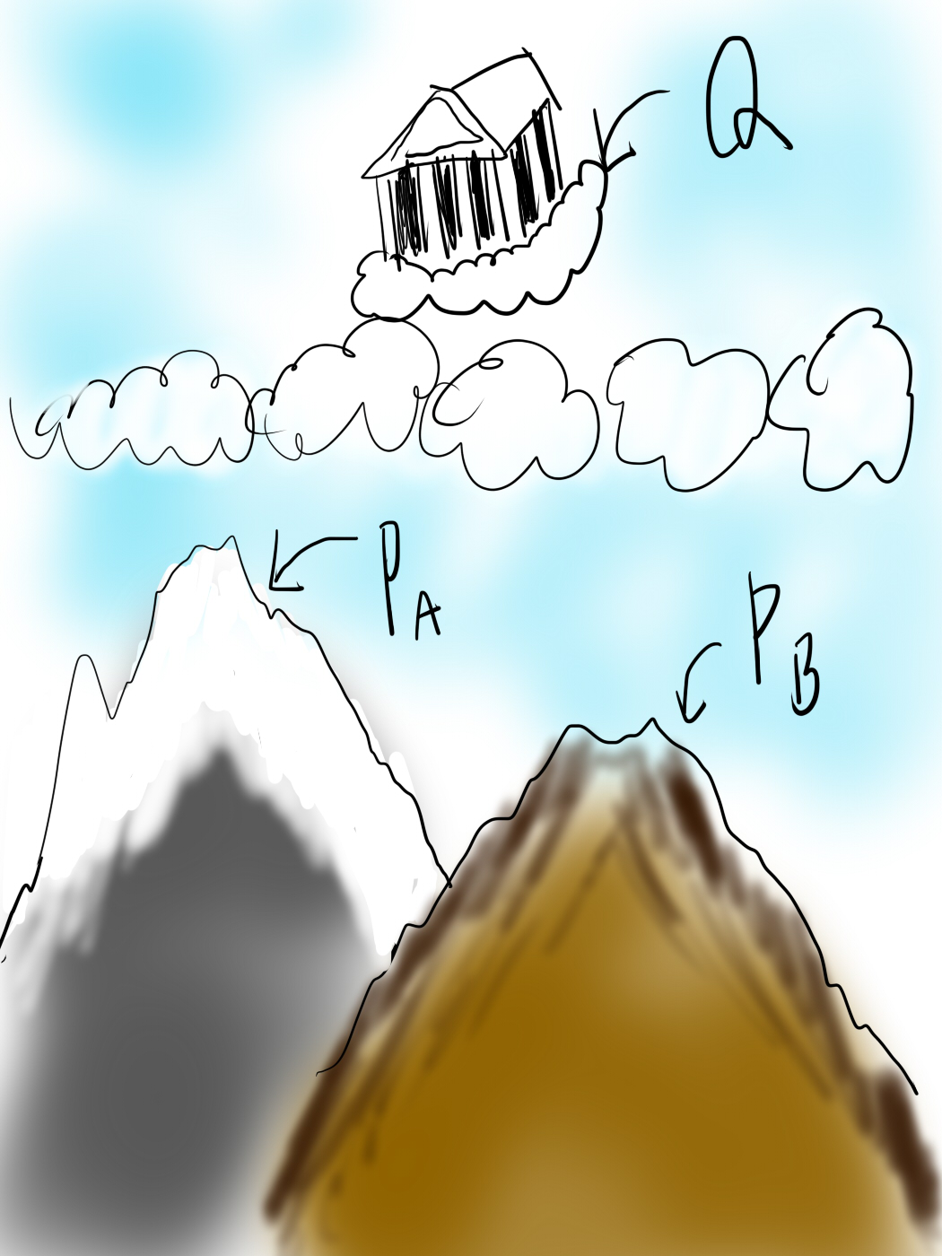


Slide 6
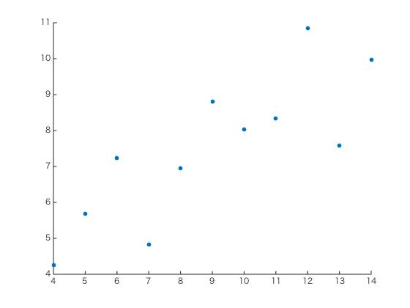
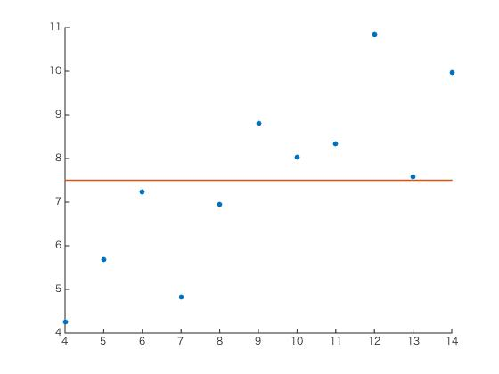
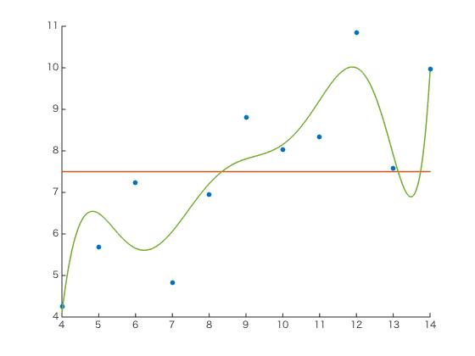
Complexity

Slide 7
Complexity
Simple
Complex

Slide 8
AIC
AIC:
Fit: log Likelihood
Complexity: # of parameters
For example…
AIC
-26.3
0
52.6
-13.5
8
41.0
-16.9
2
37.7

